Slide 1

Data Science Capacity Building Initiative
Project pitching
DSCBI
DSCBI

Slide 2

Macro Dashboard
Ministry of Finance and Economic Planning (MINECOFIN)
By: Evariste Manirumva & Andrew Mushokambere
November 2025

Slide 3
Project overview and rationale
Overview:
Ministry houses data from agencies, stakeholders, and internal systems, producing reports and briefs to guide macroeconomic policy
Ministry present targets from national strategic documents (NST2, Vision 2035/50)
Dashboard: tool to track/monitor and visualize economic indicators (developments and forecasts, targets).
A framework to quick communication and dissemination of key macro indicators/targets to managers and stakeholders
Problem:
Lack of a convenient economic data sharing and information dissemination frameworks
Limited quick access and interpretation of macro indicators
Relevance/rationale: objectives
Convenient access, interpretation & dissemination of economic information
Economic surveillance and monitoring for active/real-time decision making
Solutions:
Simplified integrated macro-framework datasets
Improved data sharing, visibility and dissemination/communication

Slide 4
Tasks and team roles
Dashboard and pipeline design
Data-frame: Data collection, cleaning/appropriation
Coding and deployment: read data & dashboard implementation in python (link data to master mind)
Presentation to managers for dashboard validation
Host: deploy dashboard to website (with IT team)

Slide 5
Data
Data & sources:
MINECOFIN: Integrated Macroeconomic Framework (t, t+1)
NISR: National Account (Qo, t)
BNR: Monetary indicators
National strategic documents
Data type:
Annual and Quarterly frequency period & time resolution, etc.
Annual forecasts: economic projections (Semester basis (twice a year))
Economic development targets
Indicators:
Macro-indicators (GDP, CPI and Exchange Rates)
Fiscal (Revenue, Tax and spending and grants)
Debt (Debt stock, interest rates payment)
Memorandum items (i.e., employment, poverty, interest rates…)

Slide 6
Methodology
Data processing:
Create database and connection:
Read data using Python modules (i.e., pandas & numpy…)
Connection to database using Postgres/sql
Visualization techniques:
Python(prog. language) and python visualization packages (i.e., streamlit, dash)
Deployment for external access (http links, hook dashboard to website…)

Slide 7
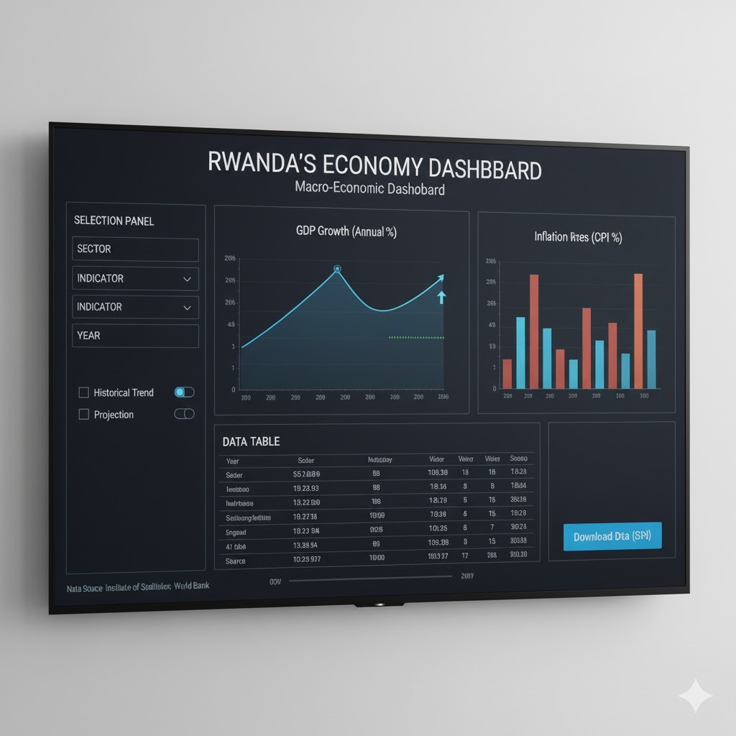
Progress/achievements
Master-plan
Key achievements/deliverables: A running dashboard Skelton
Cleaned Dataset read for use
Drafted Python codes/script
Dashboard hosted (local host)
Current status/developments:
Dataset additional indicators
Dashboard design/visibility finetuning (dynamism and interactivity reference to templates)
Exploring alternative visualization tool/packages incl. Dash, Bokeh and Altear

Slide 8

Progress/achievements: prel. products
Demo visualization

Slide 9
Conclusions and recommendations
Key takeaways:
Learning/acquiring new & golden knowledge
Understanding real world trends: AI and LLM models
Exploring and extending potentials (capacity and application)
Program relevance on current and future career.
Recommendations:
Showcasing dashboard for validation and ownership:
Internal consultations: for content, visibility and data validation
Hosting: consultations and cooperation with IT, communication and website management team

Slide 10
Next steps and work plan
Planned activities (By Dec 2025):
Data, dashboard design/visibility finetuning (interactive & dynamic and automation)
Exploring alternative visualization tool/packages (Dash, Bokeh and Altear)
Additional data collection (Inclusion of development indicators)
Deployment and hosting
Project scaling & further applications:
Dashboard extension--AI/LLM application: AI assistant for summary note/report behind data/statistics
Develop APIs and Auto data portals
AI/LLM in reporting automation—reports reader assistant (i.e., national strategic/policies documents, regular reports/news letter on websites)
ML in nowcasting and forecasting

